Slide 1
Beyond the Mortgage:
Vision 2025
“They broke bread in their homes and ate together with glad and sincere hearts, praising God and enjoying the favor of all the people. And the Lord added to their number daily.” Acts 2: 46-47
Notes:
(Entry and gathering slide. Click to advance.)

Slide 2
Thank you for your generous support to St. Francis.
“Give to the Most High as He has given to you, generously according to your means. For the Lord is one who always repays, and He will give back to you seven fold.” Sirach 4:13

Slide 3
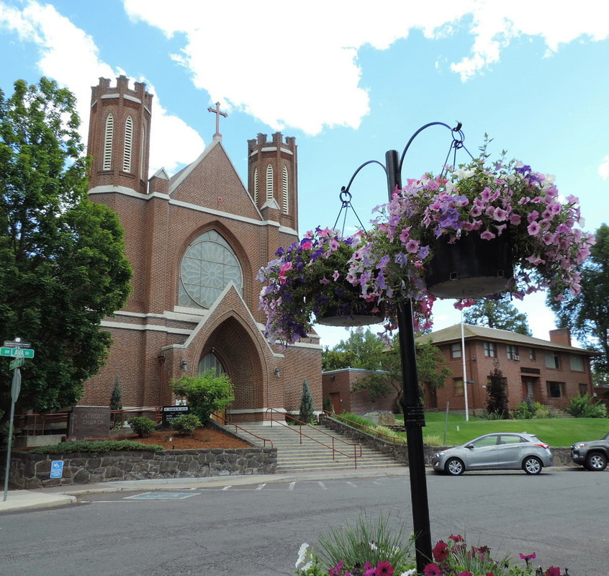
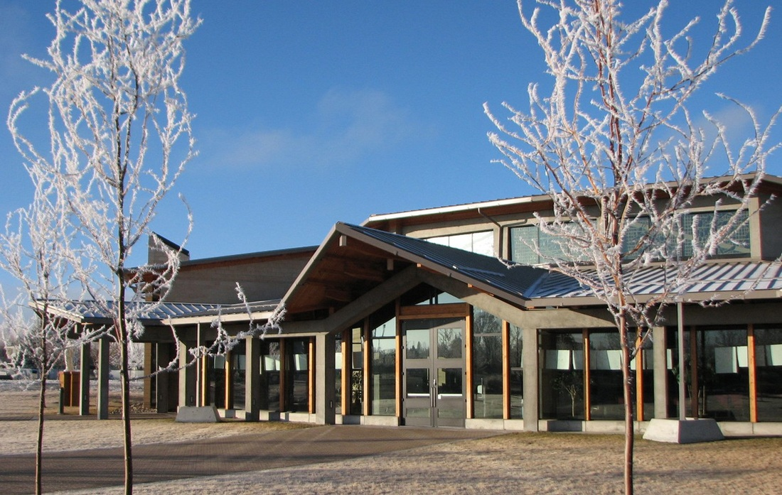
Press on toward the goal (Phil. 3:14)
“The greatest among you must be your servant. Whoever exalts himself will be humbled; but whoever humbles himself will be exalted."
Notes:
(Pulls the curtains back with welcoming.)

Slide 4
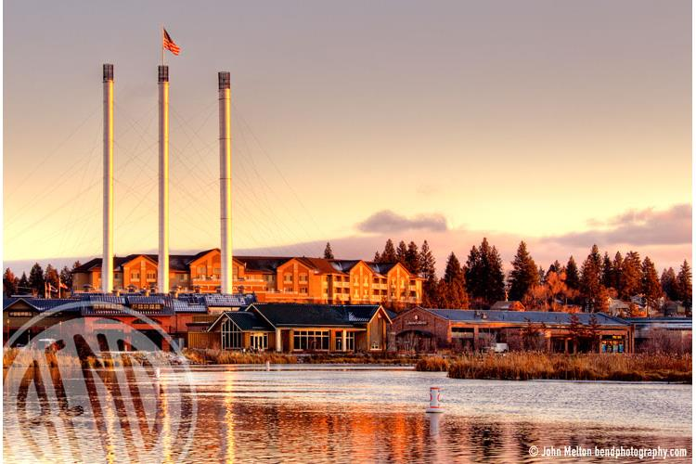
Bend growth*
8th Fastest growing city in US
Growth Last Year: 3.2% (2740 People)
Population 2010: 76,639
Population 2015: 87,014
Population 2018: 97,590
Forecast 2025: 115,000
Forecast 2065: 194,793
*KTVZ report May 23, 2019

Slide 5
Our Vision
To become a church family centered on the Eucharist where everyone feels welcomed, has a deep sense of belonging and enabled to become good stewards and intentional Disciples of Christ.
Vision for next 3-5 years
Notes:
(Parish Vision)

Slide 6
Our Mission
St. Francis of Assisi Catholic Church in Bend, Oregon strives to be a community that lives and shares the Gospel of Jesus Christ through prayer, love, and service.
Notes:
(Mission Statement)

Slide 7
Reason for Our Existence?
Making Disciples
Evangelization
Notes:
(Two-click slide. The topic line, then yellow lines pop forward.)

Slide 8
How do we do it?
Church
with
School
Notes:
(Two-click slide. The topic line, then yellow lines pop forward.)

Slide 9
Living and Sharing the Gospel
Evangelization and Catechesis
“Go therefore and make disciples of all nations, baptizing them in the name of the Son and of the Holy Spirit, teaching them to observe all that I have commanded you. And behold, I am with you always, to the end of the age.”
Mt 28:19-20
Notes:
(Click to change slide.)

Slide 10
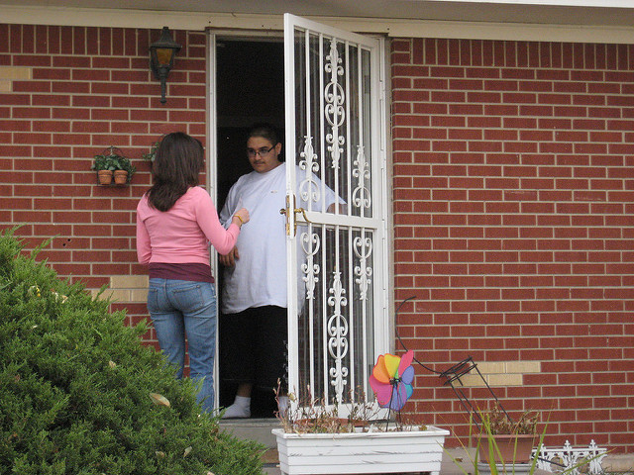
Making Disciples – What has been accomplished:
Reaching out to inactive Catholics
Returning Catholics Ministry
Notes:
(Each click advances another topic.)

Slide 11
Making Disciples – What has been accomplished:
Reaching out to inactive Catholics
✓ Returning Catholics Ministry
Reaching out to new parishioners
✓ Welcome Ministry
Notes:
(Each click advances another topic.)

Slide 12
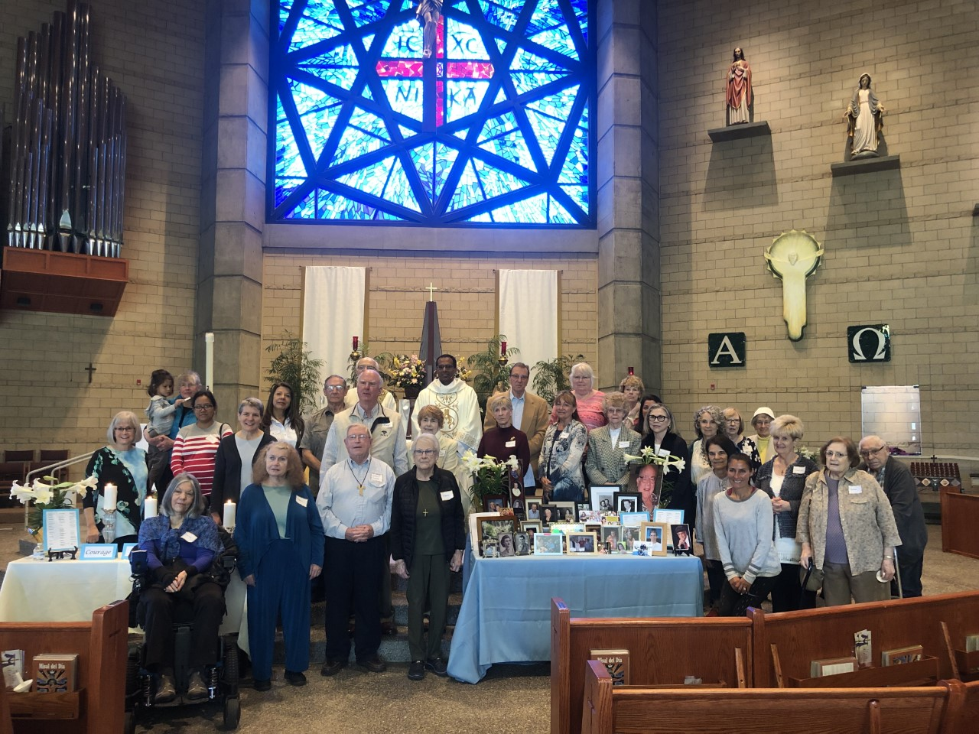
Making Disciples – What has been accomplished:
Reaching out to inactive Catholics
✓ Returning Catholics Ministry
Reaching out to new parishioners
✓ Welcome Ministry
Reaching out to who grieve
✓ Grief Ministry
Notes:
(Each click advances another topic.)

Slide 13
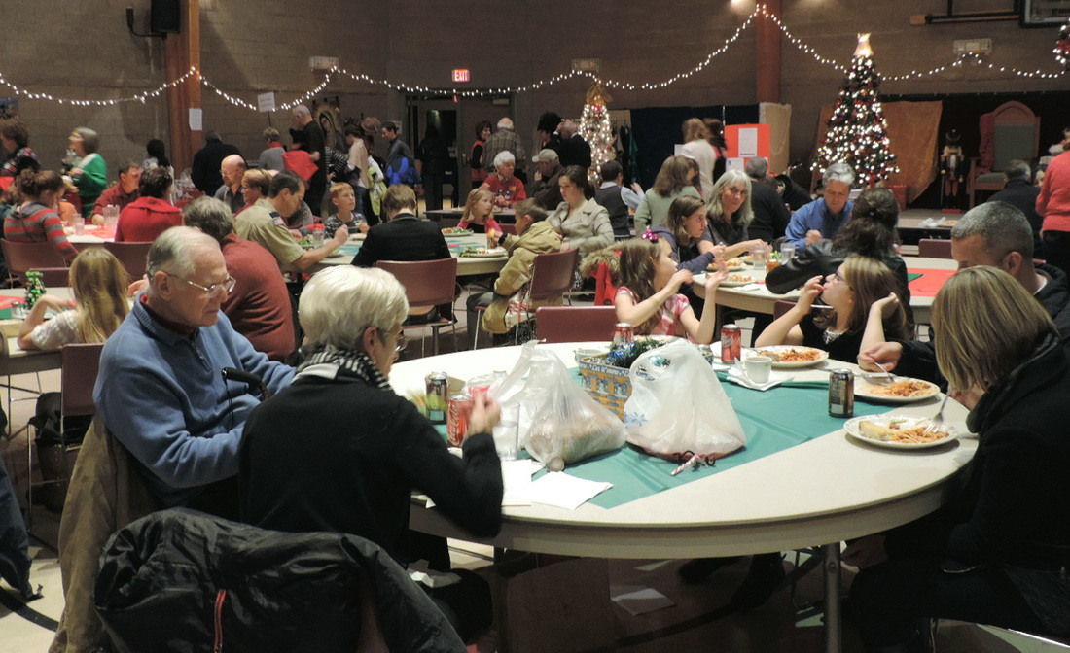
Catechesis - What has been accomplished:
Retreats
Missions
Bible Studies
Eucharistic Adoration
Night Vigil : First Friday – First Saturday
Pilgrim Virgin statue visits
Relic of St. John Vianney
Prayer groups
Notes:
(Each click advances another topic.)

Slide 14
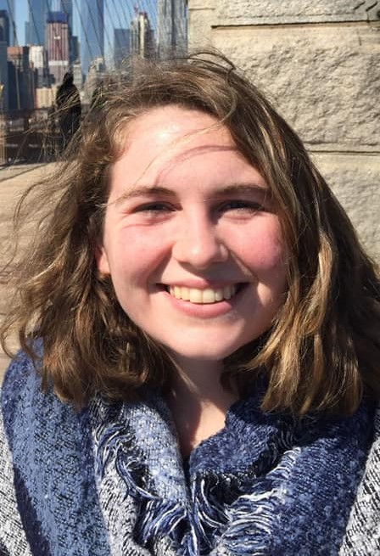
Catechesis - What has been accomplished:
Youth and Young Adult
minister hired
Notes:
(Each click advances another topic.)

Slide 15
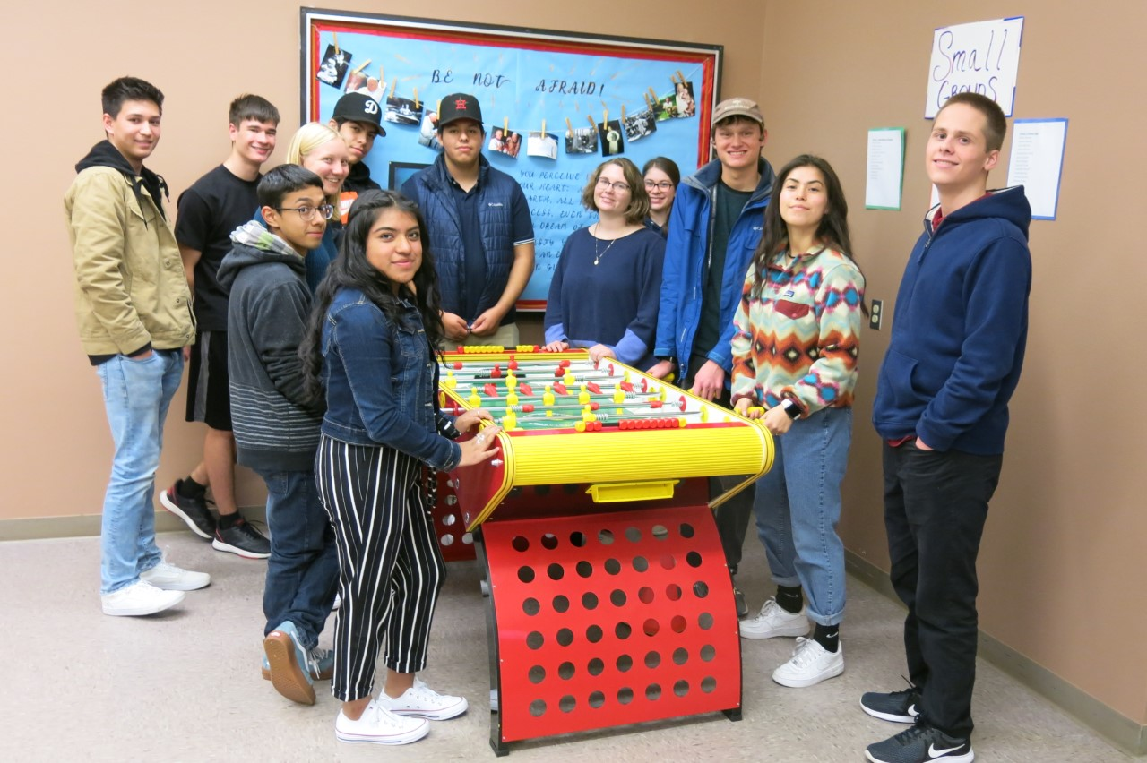
Catechesis - What has been accomplished:
Youth Ministry
Campus Bible Study -
Kairos at COCC
Notes:
(Each click advances another topic.)

Slide 16
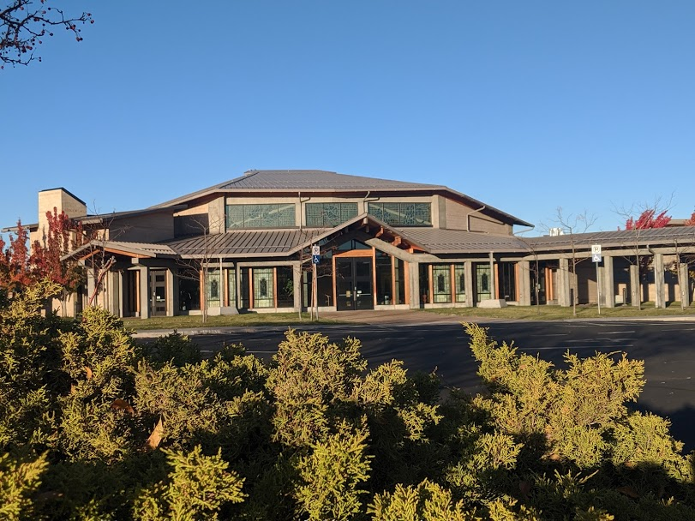
Fiscal stewardship – What has been accomplished:
Paid off the mortgage
$3.1 Mil. in 2.5 years
Notes:
(Each click advances another topic.)

Slide 17
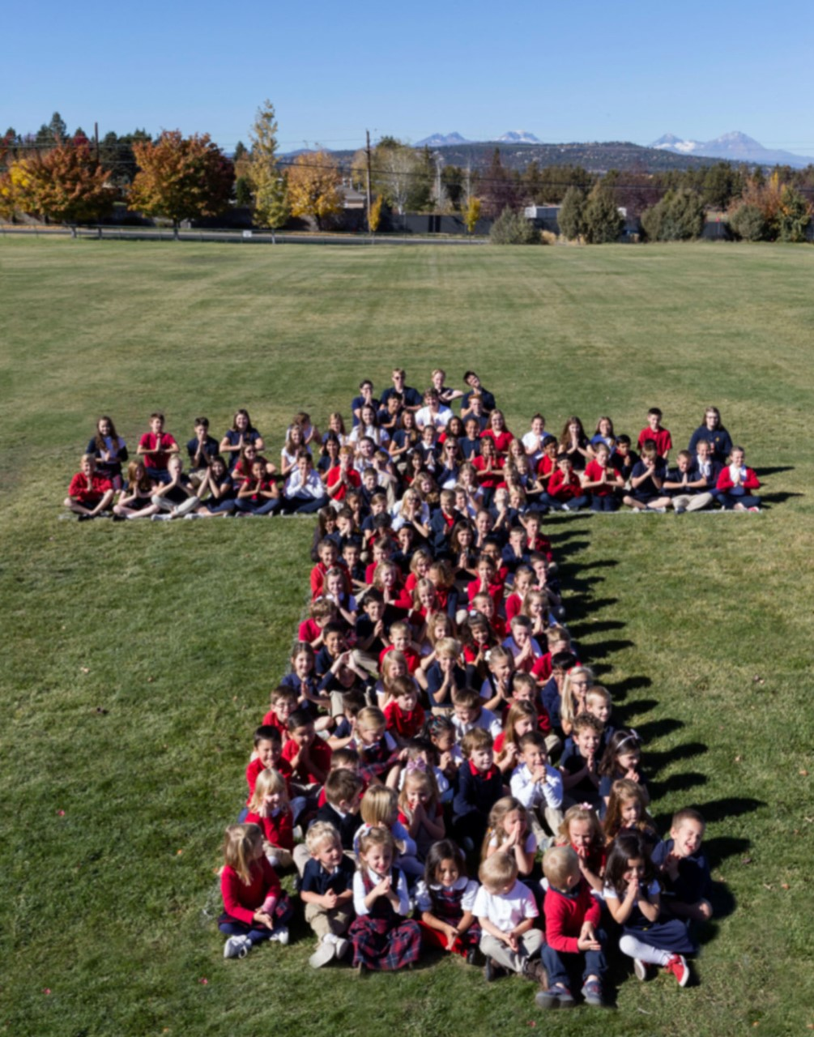
Fiscal stewardship – What has been accomplished:
Greater financial support to the school : $120,000 + 47,000
Replaced carpets in 10 class rooms
Nuns full time teaching
Constructed a convent
Established scholarship fund
23 students: $35,000
Notes:
(Each click advances another topic.)

Slide 18
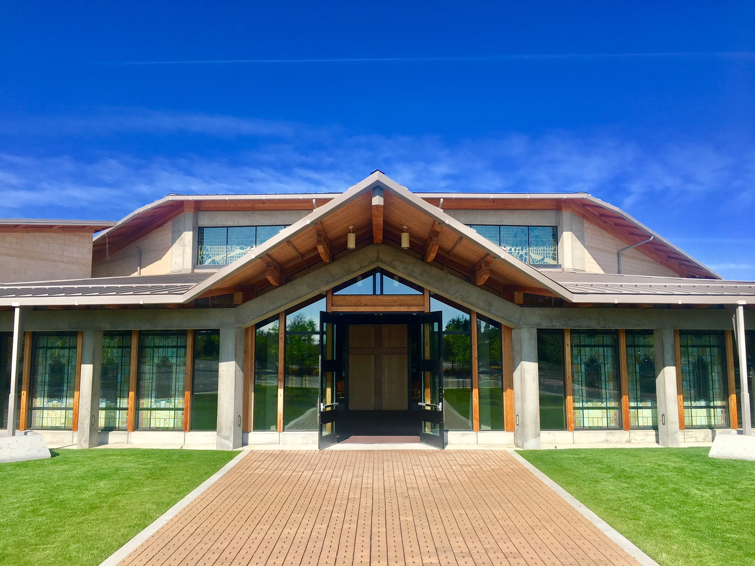
Fiscal stewardship – What has been accomplished:
Upgraded the Heating System
Cost: $267,744
Energy Incentive: $91,887
Church Expense: $175,857
Notes:
(Each click advances another topic.)

Slide 19
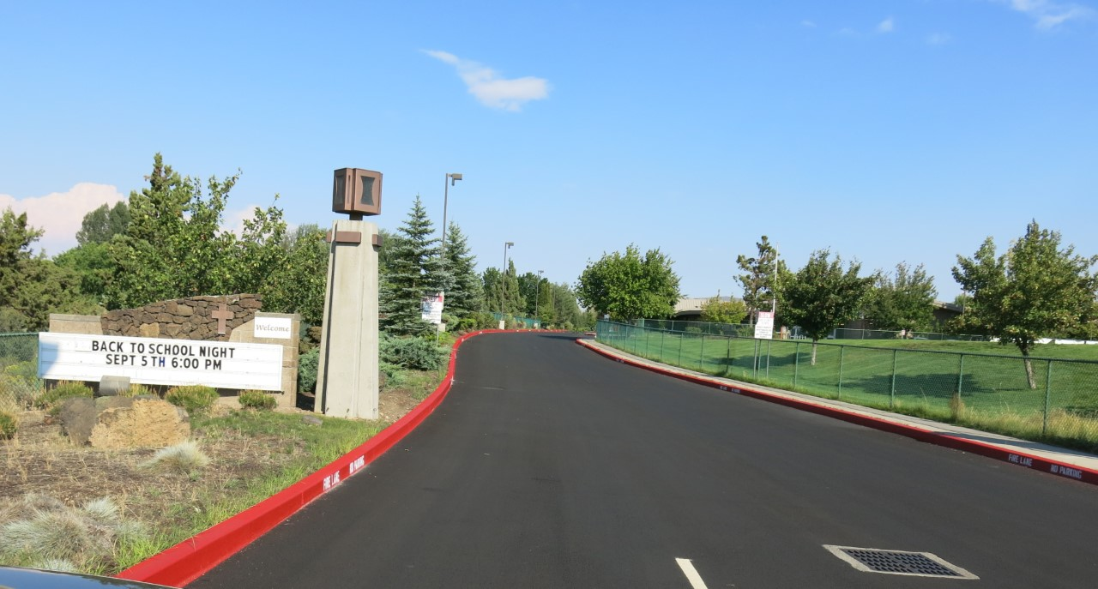
Fiscal stewardship – What has been accomplished:
Repaved the driveway
Thanks to:
Dan &
Kristine McLean
Tri County Paving
Expense: $48,000
Notes:
(Each click advances another topic.)

Slide 20
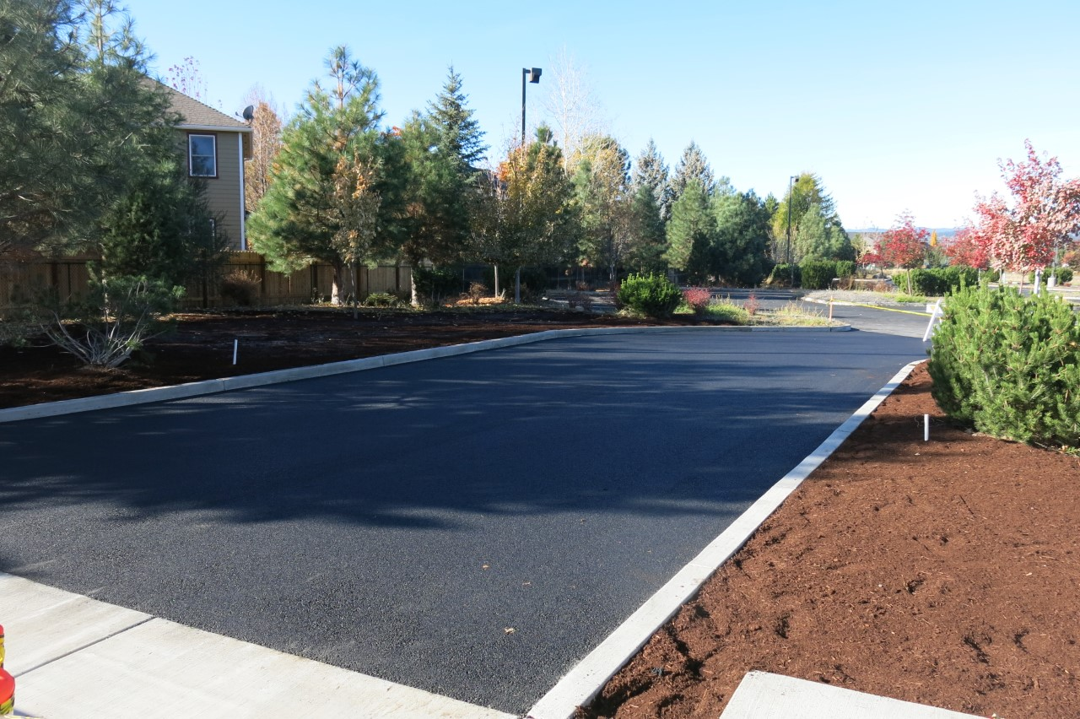
Fiscal stewardship – What has been accomplished:
Opened another access
Thanks to:
Dan & Kristine McLean
Tri County Paving
Expense: $25,000
Notes:
(Each click advances another topic.)

Slide 21
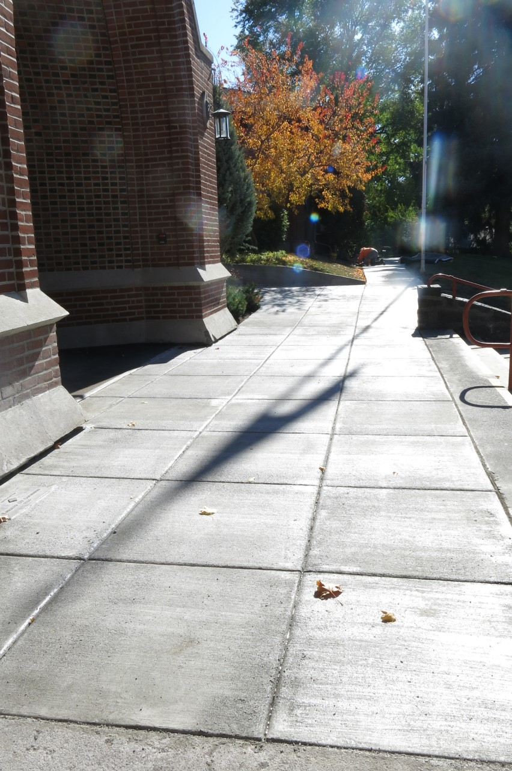
Fiscal stewardship – What has been accomplished:
Replaced the walkway with radiant heat
Thanks to:
- Kevin Link: Project Manager
- White River Construction
- Bend Heating
Cost: $47,000
Notes:
(Each click advances another topic.)

Slide 22
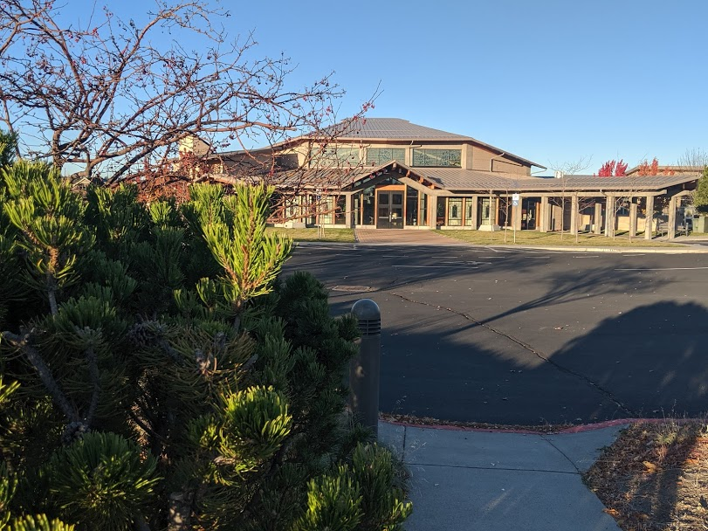
Beyond the Mortgage: Vision 2025
Paid off the mortgage. Sit back and relax?
Notes:
(Each click advances another topic.)

Slide 23
Beyond the Mortgage: Vision 2025
Evangelization & Catechesis: Our Mission
Religious Landscape in the US*
Groups | 2009 | May 2019
Atheists, Agnostics, Nothing in particular | 17% | 26%
Those who identify as Christians | 77% | 65%
Protestants | 51% | 43%
Catholics | 23% | 20%
Catholics who:
Attend Mass once a week: 22%
Monthly: 30%
Few times a year: 45%
millennials: 64%
*Pew Research Center
Notes:
(Each click advances another topic.)

Slide 24
Beyond the Mortgage: Vision 2025
Evangelization & Catechesis
Retreats
Missions
Bible Studies
Eucharistic Adoration
Night Vigil : First Friday – First Saturday
Home Enthronements
Prayer Groups
Notes:
(Each click advances another topic.)

Slide 25
Beyond the Mortgage: Vision 2025
Evangelization & Catechesis
Create and implement promotional TV & radio spots
Pilgrimages
Catechesis on various Catholic topics
Growing youth ministry
Growing Campus Ministry
Growing Young Adult Ministry
Equipping parents with tools to protect families
Making help available for those struggling with addictions
Notes:
(Each click advances another topic.)

Slide 26
Beyond the Mortgage: Vision 2025
Evangelization & Catechesis
Evaluate our Family Evangelization: School & RE
Identify & implement parish renewal process
Create outreach to inactive Catholics and unchurched
Evaluate our “Sunday experience” and address issues
Build Parish App
Notes:
(Each click advances another topic.)

Slide 27
Beyond the Mortgage: Vision 2025
Community Building
Social and Fellowship gatherings
Evaluate parishioner engagement & address identified issues
Create links to community organizations to serve those we are now missing
Summer camps
Notes:
(Each click advances another topic.)

Slide 28
Beyond the Mortgage: Vision 2025
Community Outreach
St. Vincent De Paul
Community Kitchen
Bethlehem Inn
Pregnancy Resource Center
Grandma’s House
Kids Center
Notes:
(Each click advances another topic.)

Slide 29
Beyond the Mortgage: Vision 2025
School
Notes:
(Each click advances another topic.)

Slide 30
Beyond the Mortgage: Vision 2025
School
Enrollment: 230 students
School bus
Scholarship fund: $1 mil.
Currently: $100K
Notes:
(Each click advances another topic.)

Slide 31
Beyond the Mortgage: Vision 2025
Facilities: Fiscal Stewardship
Renovation of the Historic church
$200,000 each year for the next 3 years.
How do we come up with the money?
Mortgage was $27,000 x 12 = $324,000
Historic Church: $200,000
School support: $124,000
Notes:
(Each click advances another topic.)

Slide 32
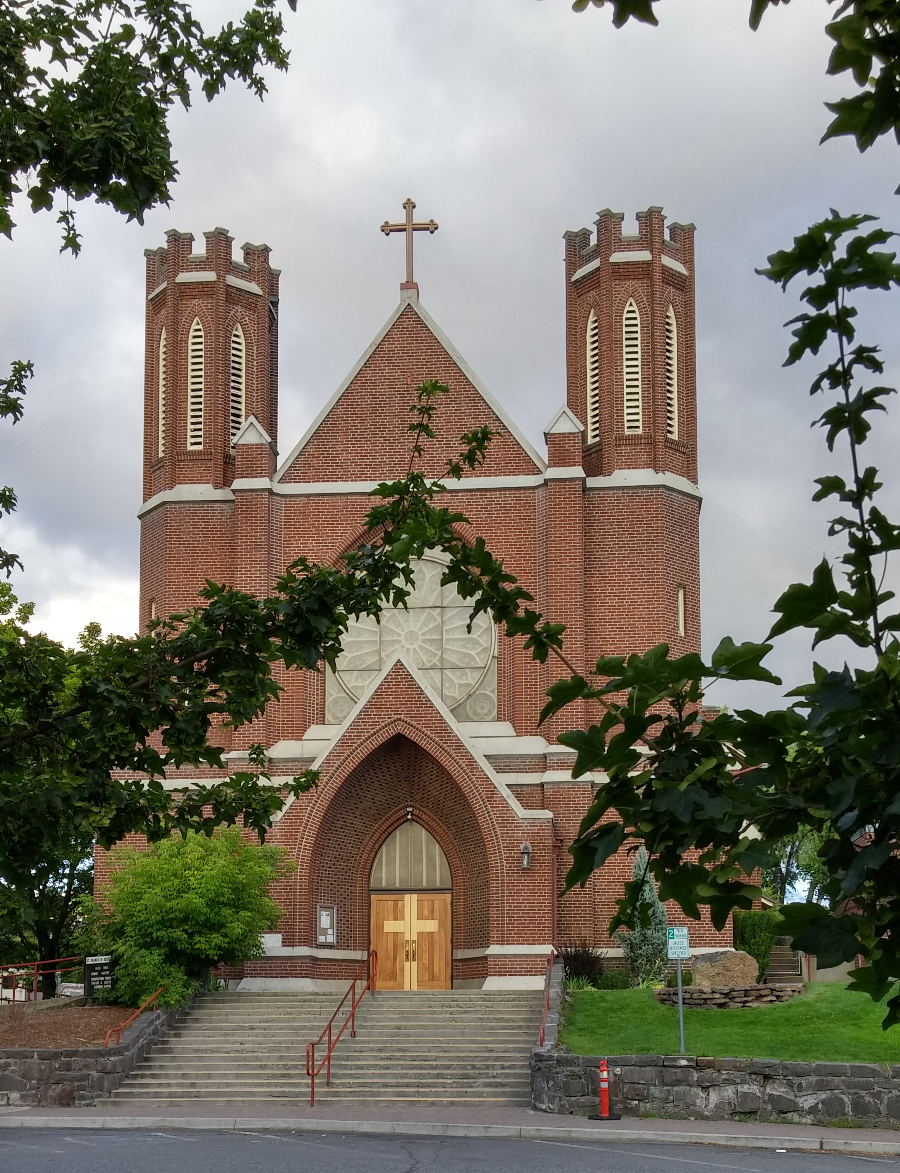
Beyond the Mortgage: Vision 2025
Facilities: Fiscal Stewardship
100th Anniversary Celebration
Notes:
(Each click advances another topic.)

Slide 33
Beyond the Mortgage: Vision 2025
Facilities: Fiscal Stewardship
Rectory at 27th St. Church
$$$ ?
Address deferred maintenance
Complete the 3rd access to 27th St.
Security system upgrade
Newer equipment for maintenance.
Notes:
(Each click advances another topic.)

Slide 34
Two Parishes
Kinder for our priests
More benefits to parishioners
Notes:
(Click to change slide.)

Slide 35
Master Plan
Parish Hall
Additional ministry opportunities
Frees the school gymnasium/center
Reduces a nightmare of logistics
Notes:
(Click to change slide.)

Slide 36
Beyond the Mortgage: Vision 2025
A Growing Community
Registered households: 1856
New registrations in last 3 years: 277 (533 persons)
Stewardship of Giving
Families/individuals who support financially: 912 (49%)
Families/individuals who support Offertory: 832 (44%)
Notes:
(Click to bring up the fireworks. Click again to bring up next slide.)

Slide 37
Beyond the Mortgage: Vision 2025
Stewardship of Giving
Debt elimination campaign: 516 F/Is
Outstanding Pledges: 234
Redirected to Scholarship fund: 32
Redirected to Offertory: 3
Redirected to Historic Church: 5
Redirected to other causes: 2
Cancelled: 29
No Response: 163
Notes:
(Click to bring up the fireworks. Click again to bring up next slide.)

Slide 38
2020 Financial Goals
Stewardship 2020: “Press on toward the goal.”
Offertory: $1,380,000
Weekly: $26,538
Historic Church: $200,000 each for three years
Scholarship Fund: $1 Mil.
Debt elimination 2018: $487,000
Notes:
(Click to bring up the fireworks. Click again to bring up next slide.)

Slide 39
“Press on toward the goal.”
Make Disciples
Evangelize & Catechize
Deepening our commitment to Christ
Grow the Parish and School
Assess and address the unmet needs
Live the Mission as good stewards and intentional disciples of Christ
Notes:
(Two-click slide. The topic line, then yellow lines pop forward.)

Slide 40
“Press on toward the goal.”
Make Disciples
Evangelize & Catechize
“Come, work for the Lord. The work is hard, the hours are long and the pay is low. But the retirement benefits are out of this world.”
Notes:
(Two-click slide. The topic line, then yellow lines pop forward.)

Slide 41
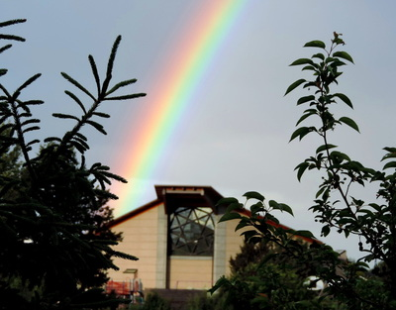
St Francis – Pray for Us
Thanks for your support
Notes:
(Click to change slide.)

